Slide 1
Student Details
Name : Dheeraj Surakasula
SkillBuild ID : iamdheeraj2614@gmail.com
College Name : Vignan Institute of Information Technology
Internship Domain and Internship start and End Date : Artificial Intelligence / 19-08-2023 to 30-09-2023

Slide 2
Sentiment Analysis of Restaurant Reviews
Unlock Customer Insights: Analyze restaurant reviews for sentiment to understand customer satisfaction.
Data-Driven Decisions: Use machine learning to categorize reviews as positive, negative, or neutral.
Enhance Dining Experience: Leverage sentiment analysis to improve food, service, and ambiance.
Actionable Feedback: Gain valuable insights for informed decision-making and customer-focused improvements.

Slide 3
AGENDA
Project Overview
Who are end Users
Solution and its valuble proposition
project Customization
Modelling
Results
Links

Slide 4
PROJECT OVERVIEW
Objective: Analyzing customer reviews to gauge sentiment (positive, negative) towards restaurant experiences.
Methodology: Utilizing natural language processing (NLP) techniques and machine learning models to automatically classify sentiments.
Benefits:
Improved Customer Satisfaction: Identifying areas for restaurant improvement.
Real-time Feedback: Providing instant feedback for restaurant owners.

Slide 5
WHO ARE THE END USERS of this project?
1. Restaurant Owners:To gain insights into customer sentiment and make improvements.
2. Restaurant Managers: For real-time feedback analysis and decision-making.
3. Customers: To view summarized sentiments and make informed dining choices.
4. Food Critics: To supplement their reviews with sentiment data for analysis.
5. Data Analysts: For in-depth sentiment trends and reports.

Slide 6
YOUR SOLUTION AND ITS VALUE PROPOSITION
Our sentiment analysis for restaurant reviews leverages advanced natural language processing (NLP) techniques and machine learning models to automatically classify customer sentiments in restaurant reviews.
Value Proposition:
Efficient Insights: Quickly identify positive, negative, and neutral sentiments in reviews.
Improved Customer Experience: Empower restaurants to make data-driven improvements.
Real-time Feedback: Provide instant feedback to enhance restaurant operations.
Competitive Advantage:Gain an edge by understanding customer sentiments.
Enhanced Decision-making: Enable stakeholders to make informed choices for growth.
Customer Satisfaction: Ultimately, our solution leads to happier customers and better dining experiences.

Slide 7
How did you customize the project and make it your own
While the core sentiment analysis project may not have undergone significant changes, the implementation of a Flask web application adds a layer of interactivity and usability.
By adding a Flask web application, the project becomes more interactive, user-centric, and accessible, ultimately enhancing its utility and user engagement.
Deployment of this Flask app using Heroku or AWS will be very helpful for easier access .

Slide 8
MODELLING
1. Data Preprocessing
2. Feature Extraction
3. Model Selection
4. Training and Validation
5. Hyperparameter Tuning
6. Model Evaluation
7. Deployment
8. Monitoring and Maintenance

Slide 9
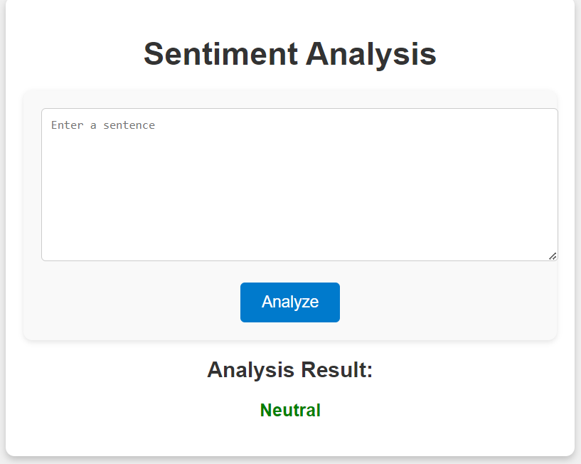
Results
Sentiment Analysis: 70% accuracy.
Web Platform: Implemented for user-friendly access.
Key Insights: Majority of reviews are positive.
User Feedback: Positive and aligns with sentiment analysis.
Future Plans: Enhance accuracy and expand web platform features.

Slide 10
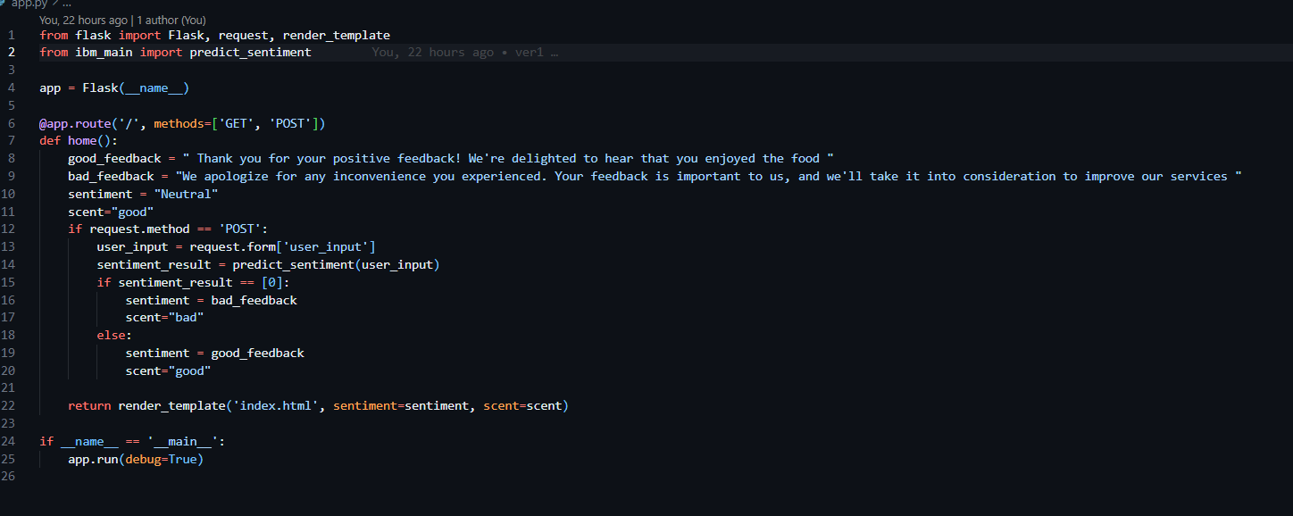
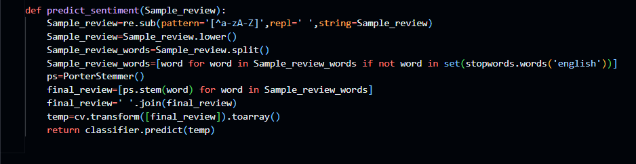
CODE Snapshots
FLASK APP CODE
NLP Code

Slide 11
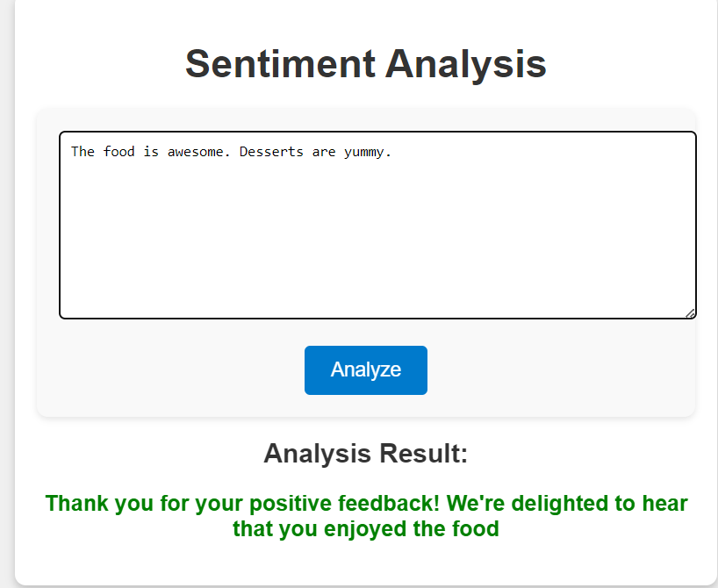
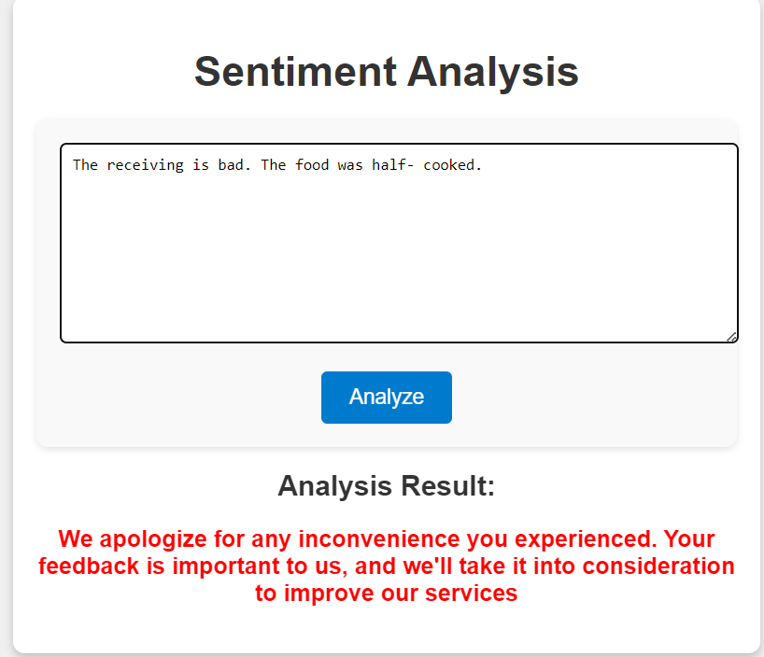
Output snaps

Slide 12
links
Project Link : https://github.com/Dheeerazzz/Feedback-Sentiment-Analysis

